Slide 1
Relations
Chapter 9

Slide 2
Chapter Summary
Relations and Their Properties
Representing Relations
Equivalence Relations
Partial Orderings

Slide 3
Relations and Their Properties
Section 9.1

Slide 4
Section Summary
Relations and Functions
Properties of Relations
Reflexive Relations
Symmetric and Antisymmetric Relations
Transitive Relations
Combining Relations

Slide 5
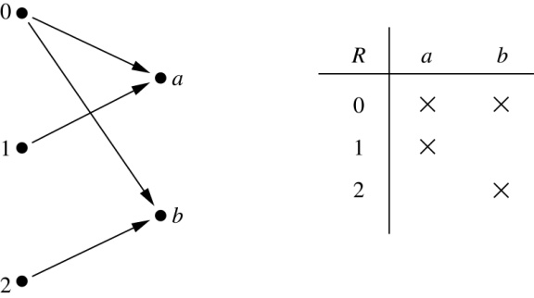
Binary Relations
Definition: A binary relation R from a set A to a set B is a subset R ⊆ A × B.
Example:
Let A = {0,1,2} and B = {a,b}
{(0, a), (0, b), (1,a) , (2, b)} is a relation from A to B.
We can represent relations from a set A to a set B graphically or using a table:
Relations are more general than functions. A function is a relation where exactly one element of B is related to each element of A.

Slide 6
Binary Relation on a Set
Definition: A binary relation R on a set A is a subset of A × A or a relation from A to A.
Example:
Suppose that A = {a,b,c}. Then R = {(a,a),(a,b), (a,c)} is a relation on A.
Let A = {1, 2, 3, 4}.
The ordered pairs in the relation R = {(a,b) | a divides b} are
(1,1), (1, 2), (1,3), (1, 4), (2, 2), (2, 4), (3, 3), and (4, 4).

Slide 7
Binary Relation on a Set (cont.)
Question: How many relations are there on a set A?

Slide 8
Binary Relation on a Set (cont.)
Question: How many relations are there on a set A?
Solution: Because a relation on A is the same thing as a subset of A ⨉ A, we count the subsets of A × A. Since A × A has n² elements when A has n elements, and a set with m elements has 2^{m} subsets, there are subsets of A × A. Therefore, there are relations on a set A.

Slide 9
Binary Relations on a Set (cont.)
Example: Consider these relations on the set of integers:
R₁ = {(a,b) | a ≤ b}, R₄ = {(a,b) | a = b},
R₂ = {(a,b) | a > b}, R₅ = {(a,b) | a = b + 1},
R₃ = {(a,b) | |a| = |b\ }, R₆ = {(a,b) | a + b ≤ 3}.
For each of these pairs, determine to which relations it belongs
(1,1), (1, 2), (2, 1), (1, −1), and (2, 2)
Note that these relations are on an infinite set and each of these relations is an infinite set.

Slide 10
Binary Relations on a Set (cont.)
Example: Consider these relations on the set of integers:
R₁ = {(a,b) | a ≤ b}, R₄ = {(a,b) | a = b},
R₂ = {(a,b) | a > b}, R₅ = {(a,b) | a = b + 1},
R₃ = {(a,b) | a = b or a = −b}, R₆ = {(a,b) | a + b ≤ 3}.
For each of these pairs, determine to which relations it belongs
(1,1), (1, 2), (2, 1), (1, −1), and (2, 2)?
Solution: Checking the conditions that define each relation, we see that the pair (1,1) is in R₁, R₃, R₄ , and R₆: (1,2) is in R₁ and R₆: (2,1) is in R₂, R₅, and R₆: (1, −1) is in R₂, R₃, and R₆ : (2,2) is in R₁, R₃, and R₄.
Note that these relations are on an infinite set and each of these relations is an infinite set.

Slide 11
Reflexive Relations
Definition: R is reflexive iff (a,a) ∊ R for every element a ∊ A. Written symbolically, R is reflexive if and only if
∀x[x∊A ⟶ (x,x) ∊ R]
Example: The following relations on the set of integers are reflexive:
R₁ = {(a,b) | a ≤ b},
R₃ = {(a,b) | |a| = |b| },
R₄ = {(a,b) | a = b}.
The following relations are not reflexive:
R₂ = {(a,b) | a > b} (note that 3 ≯ 3),
R₅ = {(a,b) | a = b + 1} (note that 3 ≠3 + 1),
R₆ = {(a,b) | a + b ≤ 3} (note that 4 + 4 ≰ 3).
If A = ∅ then the empty relation is reflexive vacuously: The empty relation on an empty set is reflexive!

Slide 12
Symmetric Relations
Definition: R is symmetric iff (b,a) ∊ R whenever (a,b) ∊ R for all a,b ∊ A. Written symbolically, R is symmetric if and only if
∀x∀y [(x,y) ∊R ⟶ (y,x) ∊ R]
Example: The following relations on the integers are symmetric:
R₃ = {(a,b) | |a| = |b|},
R₄ = {(a,b) | a = b},
R₆ = {(a,b) | a + b ≤ 3}.
The following are not symmetric:
R₁ = {(a,b) | a ≤ b} (note that 3 ≤ 4, but 4 ≰ 3),
R₂ = {(a,b) | a > b} (note that 4 > 3, but 3 ≯ 4),
R₅ = {(a,b) | a = b + 1} (note that 4 = 3 + 1, but 3 ≠4 + 1).

Slide 13
Antisymmetric Relations
Definition:A relation R on a set A such that for all a,b ∊ A if (a,b) ∊ R and (b,a) ∊ R, then a = b is called antisymmetric. Written symbolically, R is antisymmetric if and only if
∀x∀y [(x,y) ∊R ∧ (y,x) ∊ R ⟶ x = y]
Example: The following relations on the integers are antisymmetric:
R₁ = {(a,b) | a ≤ b},
R₂ = {(a,b) | a > b},
R₄ = {(a,b) | a = b},
R₅ = {(a,b) | a = b + 1}.
The following relations are not antisymmetric:
R₃ = {(a,b) | |a| = |b| }
(note that both (1,−1) and (−1,1) belong to R₃),
R₆ = {(a,b) | a + b ≤ 3} (note that both (1,2) and (2,1) belong to R₆).
For any integer, if a a ≤ b and b ≤ a , then a = b.
Notes:
Note: the property “symmetric” and “antisymmetric” are not opposite. A relation may have both or neither.

Slide 14
Transitive Relations
Definition: A relation R on a set A is called transitive if whenever (a,b) ∊ R and (b,c) ∊ R, then (a,c) ∊ R, for all a,b,c ∊ A. Written symbolically, R is transitive if and only if
∀x∀y ∀z[(x,y) ∊R ∧ (y,z) ∊ R ⟶ (x,z) ∊ R ]
Example: The following relations on the integers are transitive:
R₁ = {(a,b) | a ≤ b},
R₂ = {(a,b) | a > b},
R₃ = {(a,b) | |a| = |b| },
R₄ = {(a,b) | a = b}.
The following are not transitive:
R₅ = {(a,b) | a = b + 1} (note that both (4,3) and (3,2) belong to R₅, but not (4,2)),
R₆ = {(a,b) | a + b ≤ 3} (note that both (2,1) and (1,2) belong to R₆, but not (2,2)).
For every integer, a ≤ b
and b ≤ c, then b ≤ c.

Slide 15
Combining Relations
Given two relations R₁ and R₂, we can combine them using basic set operations to form new relations such as R₁ ∪ R₂, R₁ ∩ R₂, R₁ − R₂, and R₂ − R₁.
Example: Let A = {1,2,3} and B = {1,2,3,4}. The relations R₁ = {(1,1),(2,2),(3,3)} and R₂ = {(1,1),(1,2),(1,3),(1,4)} can be combined using basic set operations to form new relations:
R₁ ∪ R₂ ={(1,1),(1,2),(1,3),(1,4),(2,2),(3,3)}
R₁ ∩ R₂ ={(1,1)}
R₁ − R₂ ={(2,2),(3,3)}
R₂ − R₁ ={(1,2),(1,3),(1,4)}

Slide 16
Composition
Definition: Suppose
R₁ is a relation from a set A to a set B.
R₂ is a relation from B to a set C.
Then the composition (or composite) of R₂ with R₁, is a relation from A to C where
if (x,y) is a member of R₁ and (y,z) is a member of R₂, then (x,z) is a member of R₂∘ R₁.

Slide 17
Representing the Composition of a Relation
R₁
R₂
w
m
a
x
n
b
y
o
c
p
z

Slide 18
Composition of a relation with itself
Definition: Suppose R is a relation on a set A.
Then the composition (or composite) of R with R, denoted by R∘ R, is a relation on A where
if (x,y) is a member of R and (y,z) is a member of R, then (x,z) is a member of R∘ R.
Example: Let R be the relation on the set of all people
such that (a, b) is in R if person a is parent of person b. Then (a, c) is in (R∘ R) iff there is a person b such that
(a, b) is in R and (b, c) is in R. In other words, (a, c) is in R if and only if a is a grandparent of c.

Slide 19
Powers of a Relation
Definition: Let R be a binary relation on A. Then the powers R^{n} of the relation R can be defined recursively by:
Basis Step: R¹ = R
Recursive Step: R^{n+1} = R^{n} ∘ R
The powers of a transitive relation are subsets of the
relation. This is established by the following theorem:
Theorem 1: The relation R on a set A is transitive iff R^{n} ⊆ R for all positive integers n.
(see the text for a proof via mathematical induction)

Slide 20
N-ary relations
Definition: Let A1, A2, ..., An be sets. An n-ary relation on these sets is a subset of A1 x A2 x ... x An. The sets A1, A2, ..., An are called the domains of the relation and n is called the degree.
Example: Let R be the ternary relation on Z x Z x Z+ consisting of triples (a, b, m) where
Then (-1, 9, 5), (8, 2, 3) and (14, 0, 7) belong to R, but
(7, 2, 3) does not.
Example: Let R’ be the relation consisting of 5-tuples
(A, N, S, D, T) representing airplane flights, where A is the airline, N is the flight number, S is the starting point, D is the destination and T is the departure time. The degree of this relation is 5.

Slide 21
Databases and Relations
Relations are often used to represent databases
Relations used to represent databases are also called tables, because they are often displayed as tables
The database query language SQL (Structured Query Language) is used to carry out operations on tables
Each column of the table corresponds to an attribute
The natural join binary operator combines two tables into one, when these tables share some identical fields.
The result of the natural join between R and S is the set of all combinations of tuples in R and S that are equal on their common attribute names.

Slide 22
Natural Join Example
A table contains fields for airline, flight number, and gate
A second table contains fields for flight number, gate, and departure time.
One can use natural join to combine these two relations into a third one containing fields for airline, flight number, gate and departure time.

Slide 23
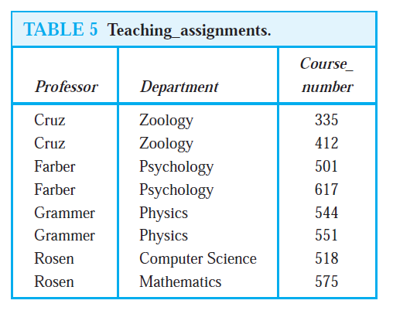
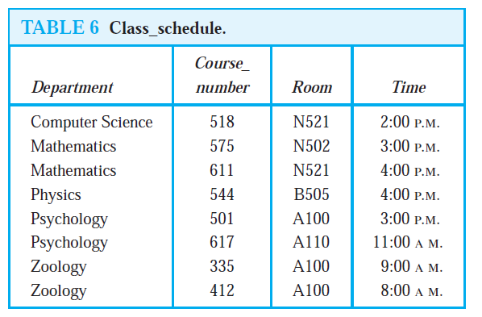
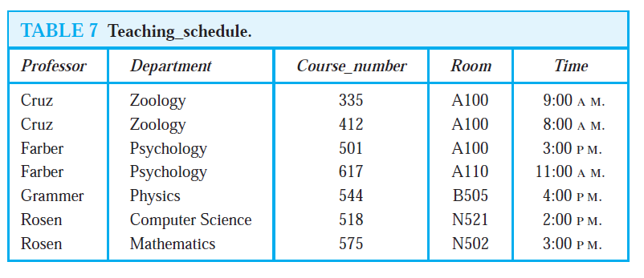
(Table 5) natural join ((Table 6) = (Table 7)

Slide 24
Representing Relations
Section 9.3

Slide 25
Section Summary
Representing Relations using Matrices
Representing Relations using Digraphs

Slide 26
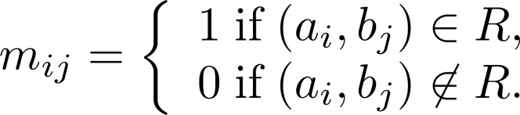
Representing Relations Using Matrices
A relation between finite sets can be represented using a zero-one matrix.
Suppose R is a relation from A = {a₁, a₂, …, a_{m}} to B = {b₁, b₂, …, b_{n}}.
The elements of the two sets can be listed in any particular arbitrary order. When A = B, we use the same ordering.
The relation R is represented by the m x n matrix M_{R} = [m_{ij}], where
The matrix representing R has a 1 as its (i,j) entry when a_{i} is related to b_{j} and a 0 if a_{i} is not related to b_{j}.

Slide 27
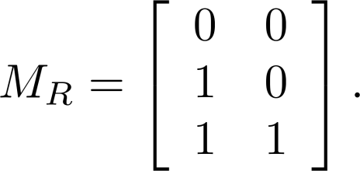
Examples of Representing Relations Using Matrices
Example 1: Suppose that A = {1,2,3} and B = {1,2}. Let R be the relation from A to B containing (a,b) if a ∈ A, b ∈ B, and a > b. What is the matrix representing R (assuming the ordering of elements is the same as the increasing numerical order)?
Solution: Because R = {(2,1), (3,1),(3,2)}, the matrix is

Slide 28
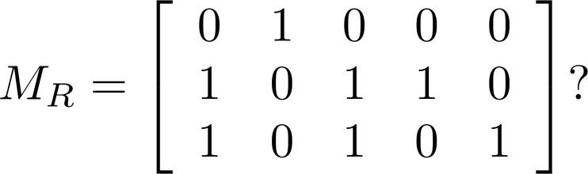
Examples of Representing Relations Using Matrices (cont.)
Example 2: Let A = {a₁,a₂, a₃} and B = {b₁,b₂, b₃,b₄, b₅}. Which ordered pairs are in the relation R represented by the matrix

Slide 29
Examples of Representing Relations Using Matrices (cont.)
Example 2: Let A = {a₁,a₂, a₃} and B = {b₁,b₂, b₃,b₄, b₅}. Which ordered pairs are in the relation R represented by the matrix
Solution: Because R consists of those ordered pairs (a_{i},b_{j}) with m_{ij} = 1, it follows that:
R = {(a₁, b₂), (a₂, b₁),(a₂, b₃), (a₂, b₄),(a₃, b₁), {(a₃, b₃), (a₃, b₅)}.

Slide 30
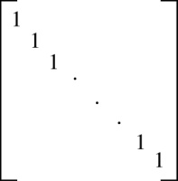
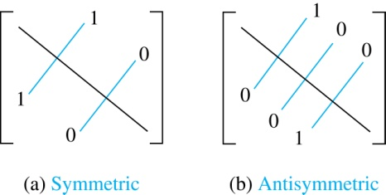
Matrices of Relations on Sets
If R is a reflexive relation, all the elements on the main diagonal of M_{R} are equal to 1.
R is a symmetric relation, if and only if m_{ij} = 1 whenever m_{ji} = 1. R is an antisymmetric relation, if and only if m_{ij} = 0 or m_{ji} = 0 when i≠ j.

Slide 31
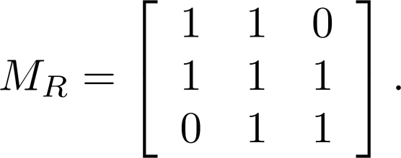
Example of a Relation on a Set
Example 3: Suppose that the relation R on a set is represented by the matrix
Is R reflexive, symmetric, and/or antisymmetric?

Slide 32
Example of a Relation on a Set
Example 3: Suppose that the relation R on a set is represented by the matrix
Is R reflexive, symmetric, and/or antisymmetric?
Solution: Because all the diagonal elements are equal to 1, R is reflexive. Because M_{R} is symmetric, R is symmetric and not antisymmetric because both m_{1,2} and m_{2,1} are 1.

Slide 33
Matrices for combinations of relations
The matrix of the union of two relations is the join (Boolean OR) between the matrices of the component relations
The matrix of the intersection of two relations if the meet (Boolean AND) between the matrices of the component relations
The matrix of the composite relation (R∘ R) is the Boolean Product between the matrix representing R and itself.

Slide 34
Joins and Meets of Zero-One Matrices
Definition: Let A = [a_{ij}] and B = [b_{ij}] be an m × n zero-one matrices.
The join of A and B is the zero-one matrix with (i,j)th entry a_{ij} ∨ b_{ij}. The join of A and B is denoted by A ∨ B.
The meet of of A and B is the zero-one matrix with (i,j)th entry a_{ij} ∧ b_{ij}. The meet of A and B is denoted by A ∧ B.

Slide 35
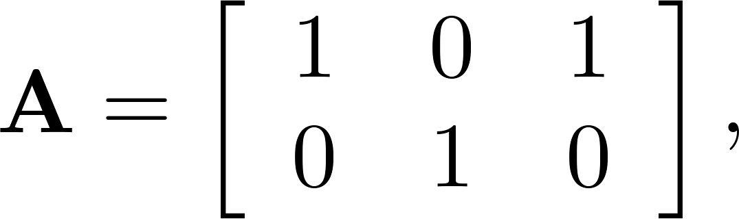
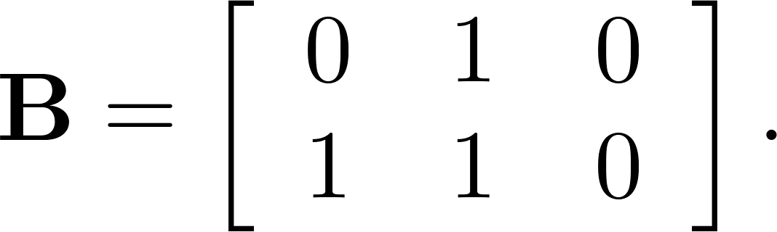
Joins and Meets of Zero-One Matrices
Example: Find the join and meet of the zero-one matrices

Slide 36

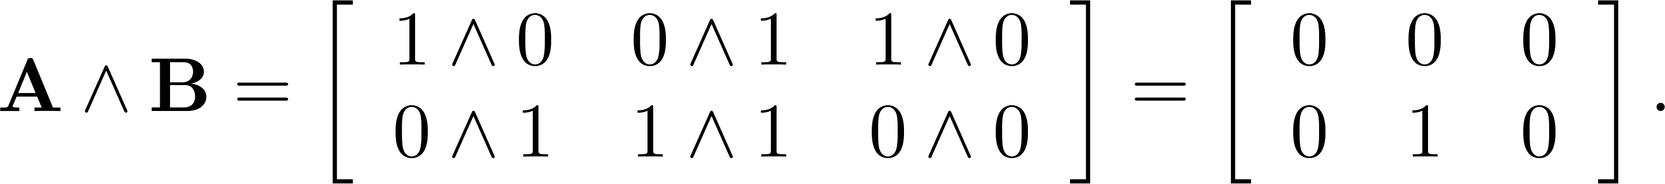
Joins and Meets of Zero-One Matrices
Example: Find the join and meet of the zero-one matrices
Solution: The join of A and B is
The meet of A and B is

Slide 37
Matrices for combinations of relations
The matrix of the union of two relations is the join (Boolean OR) between the matrices of the component relations
The matrix of the intersection of two relations if the meet (Boolean AND) between the matrices of the component relations
The matrix of the composite relation (R∘ R) is the Boolean Product between the matrix representing R and itself.

Slide 38
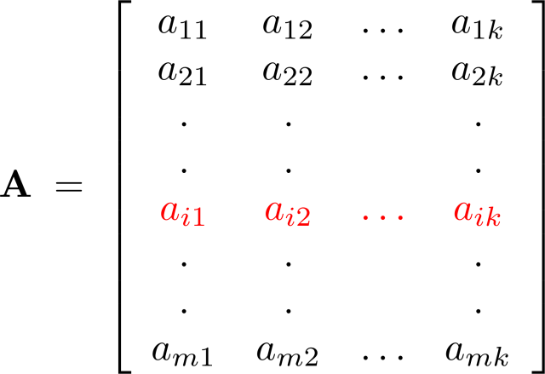
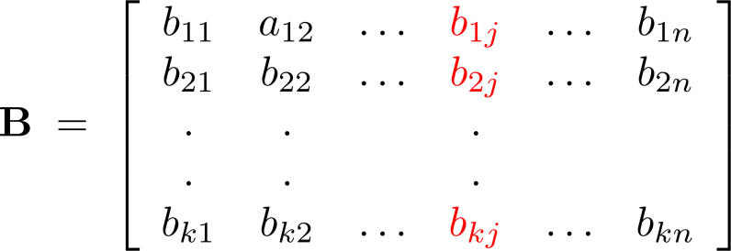
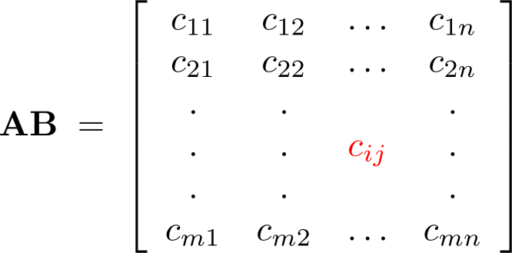
Recall Matrix Multiplication
The product of an (mxk) matrix A = [a_{is}], and
a (k x n) matrix B = [b_{sj}] is

Slide 39

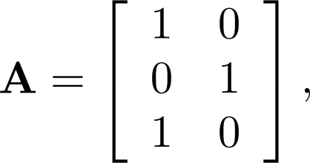
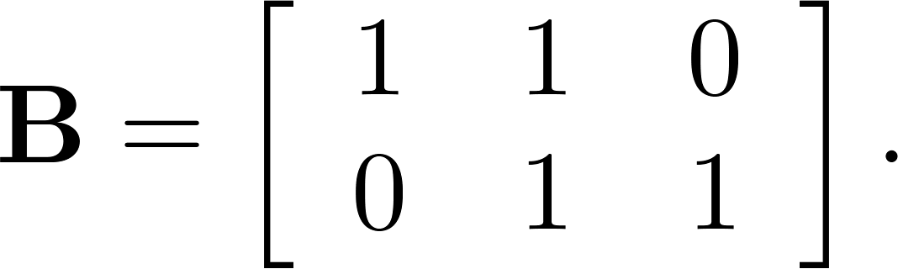
Boolean Product of Zero-One Matrices
Definition: Let A = [a_{is}] be an m k zero-one matrix and B = [b_{sj}] be a k n zero-one matrix. The Boolean product of A and B, denoted by A ⊙ B, is the m n zero-one matrix with the (i,j)th entry defined as
c_{ij} = (a_{i1} ∧ b_{1j})∨ (a_{i2} ∧ b_{2j}) ∨ … ∨ (a_{ik} ∧ b_{kj}).
Example: Find the Boolean product of A and B, where
Continued on next slide →

Slide 40
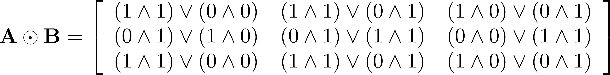
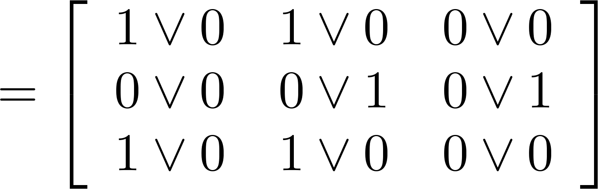
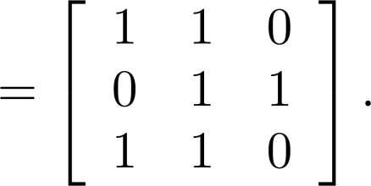
Boolean Product of Zero-One Matrices
Solution: The Boolean product A ⊙ B is given by

Slide 41
Matrices for combinations of relations
The matrix of the union of two relations is the join (Boolean OR) between the matrices of the component relations
The matrix of the intersection of two relations if the meet (Boolean AND) between the matrices of the component relations
The matrix of the composite relation (R∘ R) is the Boolean Product between the matrix representing R and itself.

Slide 42
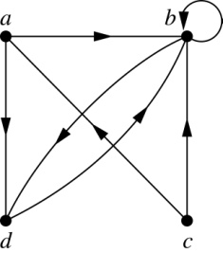
Representing Relations Using Digraphs
Definition: A directed graph, or digraph, consists of a set V of vertices (or nodes) together with a set E of ordered pairs of elements of V called edges (or arcs). The vertex a is called the initial vertex of the edge (a,b), and the vertex b is called the terminal vertex of this edge.
An edge of the form (a,a) is called a loop.
Example 7: A drawing of the directed graph with vertices a, b, c, and d, and edges (a, b), (a, d), (b, b), (b, d), (c, a), (c, b), and (d, b) is shown here.

Slide 43
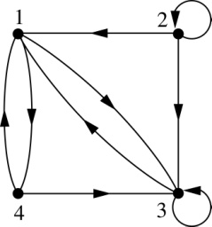
Examples of Digraphs Representing Relations
Example 8: What are the ordered pairs in the relation
represented by this directed graph?
Solution: The ordered pairs in the relation are
(1, 3), (1, 4), (2, 1), (2, 2), (2, 3), (3, 1), (3, 3), (4, 1), and (4, 3)

Slide 44
Determining Properties of a Relation from its Digraph
Reflexivity: A loop must be present at all vertices in the graph.
Symmetry: If (x,y) is an edge, then so is (y,x).
Antisymmetry: If (x,y) with x ≠ y is an edge, then (y,x) is not an edge.
Transitivity: If (x,y) and (y,z) are edges, then so is (x,z).

Slide 45
Determining Properties of a Relation from its Digraph – Example 1
a
b
c
d
Reflexive? No, not every vertex has a loop
Symmetric? Yes (trivially), there is no edge from any one vertex to another
Antisymmetric? Yes (trivially), there is no edge from any one vertex
to another
Transitive? Yes, (trivially) since there is no edge from any one vertex to another

Slide 46
Determining Properties of a Relation from its Digraph – Example 2
a
b
c
d

Slide 47
Determining Properties of a Relation from its Digraph – Example 2
a
b
c
d
Reflexive? No, there are no loops
Symmetric? No, there is an edge from a to b, but not from b to a
Antisymmetric? No, there is an edge from d to b and b to d
Transitive? No, there are edges from a to c and from c to b,
but there is no edge from a to d

Slide 48
Determining Properties of a Relation from its Digraph – Example 3
a
b
c
d

Slide 49
Determining Properties of a Relation from its Digraph – Example 3
a
b
c
d
Reflexive? No, there are no loops
Symmetric? No, for example, there is no edge from c to a
Antisymmetric? Yes, whenever there is an edge from one
vertex to another, there is not one going back
Transitive? Yes

Slide 50
Determining Properties of a Relation from its Digraph – Example 4
b
a
c
d

Slide 51
Determining Properties of a Relation from its Digraph – Example 4
b
a
c
d
Reflexive? No, there are no loops
Symmetric? No, for example, there is no edge from d to a
Antisymmetric? Yes, whenever there is an edge from one vertex
to another, there is not one going back
Transitive? Yes (trivially), there are no two edges where the first
edge ends at the vertex where the second edge begins

Slide 52
Example of the Powers of a Relation
b
a
b
a
d
c
d
c
R
R²
a
b
a
b
d
c
d
c
R⁴
R³
The pair (x,y) is in R^{n} if there is a path of length n from x to y in R
(following the direction of the arrows).

Slide 53
Equivalence Relations
Section 9.5

Slide 54
Section Summary
Equivalence Relations
Equivalence Classes
Equivalence Classes and Partitions

Slide 55
Equivalence Relations
Definition 1: A relation on a set A is called an equivalence relation if it is reflexive, symmetric, and transitive.
Definition 2: Two elements a, and b that are related by an equivalence relation are called equivalent. The notation a ∼ b is often used to denote that a and b are equivalent elements with respect to a particular equivalence relation.

Slide 56
Strings
Example: Suppose that R is the relation on the set of strings of English letters such that aRb if and only if l(a) = l(b), where l(x) is the length of the string x. Is R an equivalence relation?
Solution: Show that all of the properties of an equivalence relation hold.
Reflexivity: Because l(a) = l(a), it follows that aRa for all strings a.
Symmetry: Suppose that aRb. Since l(a) = l(b), l(b) = l(a) also holds and bRa.
Transitivity: Suppose that aRb and bRc. Since l(a) = l(b),and l(b) = l(c), l(a) = l(c) also holds and aRc.

Slide 57
Congruence Modulo m
Example: Let m be an integer with m > 1. Show that the relation
R = {(a,b) | a ≡ b (mod m)}
is an equivalence relation on the set of integers.

Slide 58
Congruence Modulo m
Example: Let m be an integer with m > 1. Show that the relation
R = {(a,b) | a ≡ b (mod m)}
is an equivalence relation on the set of integers.
Solution: Recall that a ≡ b (mod m) if and only if m divides a − b.
Reflexivity: a ≡ a (mod m) since a − a = 0 is divisible by m since 0 = 0 ∙ m.
Symmetry: Suppose that a ≡ b (mod m). Then a − b is divisible by m, and so a − b = km, where k is an integer. It follows that b − a = (− k) m, so b ≡ a (mod m).
Transitivity: Suppose that a ≡ b (mod m) and b ≡ c (mod m). Then m divides both a − b and b − c. Hence, there are integers k and l with a − b = km and b − c = lm. We obtain by adding the equations:
a − c = (a − b) + (b − c) = km + lm = (k + l) m.
Therefore, a ≡ c (mod m).

Slide 59
Divides
Example: Show that the “divides” relation on the set of positive integers is not an equivalence relation.

Slide 60
Divides
Example: Show that the “divides” relation on the set of positive integers is not an equivalence relation.
Solution: The properties of reflexivity, and transitivity do hold, but there relation is not symmetric. Hence, “divides” is not an equivalence relation.
Reflexivity: a ∣ a for all a.
Not Symmetric: For example, 2 ∣ 4, but 4 ∤ 2. Hence, the relation is not symmetric.
Transitivity: Suppose that a divides b and b divides c. Then there are positive integers k and l such that b = ak and c = bl. Hence, c = a(kl), so a divides c. Therefore, the relation is transitive.

Slide 61
Equivalence Classes
Definition 3: Let R be an equivalence relation on a set A. The set of all elements that are related to an element a of A is called the equivalence class of a. The equivalence class of a with respect to R is denoted by [a]_{R}.
When only one relation is under consideration, we can write [a], without the subscript R, for this equivalence class.
Note that [a]_{R} = {s|(a,s) ∈ R}.
If b ∈ [a]_{R}, then b is called a representative of this equivalence class. Any element of a class can be used as a representative of the class.
The equivalence classes of the relation congruence modulo m are called the congruence classes modulo m. The congruence class of an integer a modulo m is denoted by [a]_{m}, so [a]_{m} = {…, a−2m, a−m, a+m, a+2m, … }. For example,
[0]₄ = {…, −8, −4 , 0, 4 , 8 , …} [1]₄ = {…, −7, −3 , 1, 5 , 9 , …}
[2]₄ = {…, −6, −2 , 2, 6 , 10 , …} [3]₄ = {…, −5, −1 , 3, 7 , 11 , …}

Slide 62
Equivalence Classes and Partitions
Theorem 1: Let R be an equivalence relation on a set A. These statements for elements a and b of A are equivalent:
(i) aRb
(ii) [a] = [b]
(iii) [a] ∩ [b] ≠ ∅
Proof: We show that (i) implies (ii). Assume that aRb. Now suppose that c ∈ [a]. Then aRc. Because aRb and R is symmetric, bRa. Because R is transitive and bRa and aRc, it follows that bRc. Hence, c ∈ [b]. Therefore, [a]⊆ [b]. A similar argument (omitted here) shows that [b]⊆ [a]. Since [a]⊆ [b] and [b]⊆ [a], we have shown that [a] = [b].
(see text for proof that (ii) implies (iii) and (iii) implies (i))

Slide 63
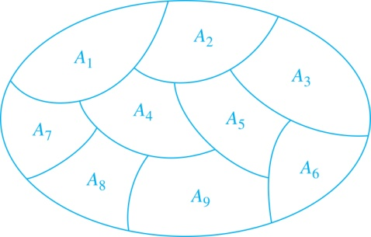
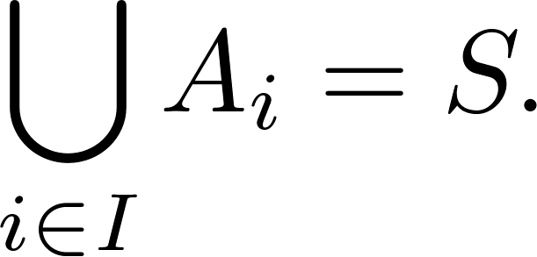
Partition of a Set
Definition: A partition of a set S is a collection of disjoint nonempty subsets of S that have S as their union. In other words, the collection of subsets A_{i}, where i ∈ I (where I is an index set), forms a partition of S if and only if
A_{i} ≠ ∅ for i ∈ I,
A_{i} ∩ A_{j}=∅ when i ≠ j,
and
A Partition of a Set

Slide 64
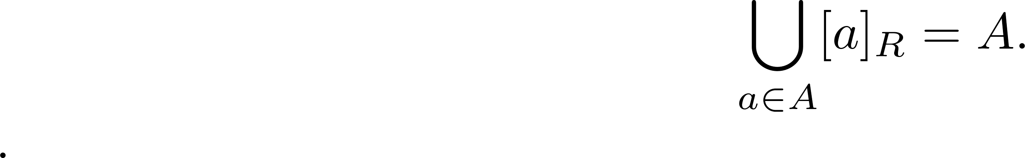
An Equivalence Relation Partitions a Set
Let R be an equivalence relation on a set A. The union of all the equivalence classes of R is all of A, since an element a of A is in its own equivalence class [a]_{R}. In other words,
From Theorem 1, it follows that these equivalence classes are either equal or disjoint, so [a]_{R} ∩[b]_{R}=∅ when [a]_{R} ≠ [b]_{R}.
Therefore, the equivalence classes form a partition of A, because they split A into disjoint subsets.

Slide 65
An Equivalence Relation Partitions a Set (continued)
Theorem 2: Let R be an equivalence relation on a set S. Then the equivalence classes of R form a partition of S. Conversely, given a partition {A_{i} | i ∈ I} of the set S, there is an equivalence relation R that has the sets A_{i}, i ∈ I, as its equivalence classes.
Proof: We have already shown the first part of the theorem.
For the second part, assume that {A_{i} | i ∈ I} is a partition of S. Let R be the relation on S consisting of the pairs (x, y) where x and y belong to the same subset A_{i} in the partition. We must show that R satisfies the properties of an equivalence relation.
Reflexivity: For every a ∈ S, (a,a) ∈ R, because a is in the same subset as itself.
Symmetry: If (a,b) ∈ R, then b and a are in the same subset of the partition, so (b,a) ∈ R.
Transitivity: If (a,b) ∈ R and (b,c) ∈ R, then a and b are in the same subset of the partition, as are b and c. Since the subsets are disjoint and b belongs to both, the two subsets of the partition must be identical. Therefore, (a,c) ∈ R since a and c belong to the same subset of the partition.

Slide 66
Partial Orderings
Section 9.6

Slide 67
Section Summary
Partial Orderings and Partially-ordered Sets
Lexicographic Orderings

Slide 68
Partial Orderings
Definition 1: A relation R on a set S is called a partial ordering, or partial order, if it is reflexive, antisymmetric, and transitive.
A set together with a partial ordering R is called a partially ordered set, or poset, and is denoted by (S, R). Members of S are called elements of the poset.

Slide 69
Partial Orderings (continued)
Example 1: Show that the “greater than or equal” relation (≥) is a partial ordering on the set of integers.
Reflexivity: a ≥ a for every integer a.
Antisymmetry: If a ≥ b and b ≥ a , then a = b.
Transitivity: If a ≥ b and b ≥ c , then a ≥ c.
These properties all follow from the order axioms for the integers. (See Appendix 1).

Slide 70
Partial Orderings (continued)
Example 2: Show that the divisibility relation (∣) is a partial ordering on the set of integers.

Slide 71
Partial Orderings (continued)
Example 2: Show that the divisibility relation (∣) is a partial ordering on the set of integers.
Reflexivity: a ∣ a for all integers a. (see Example 9 in Section 9.1)
Antisymmetry: If a and b are positive integers with a | b and b | a, then a = b. (see Example 12 in Section 9.1)
Transitivity: Suppose that a divides b and b divides c. Then there are positive integers k and l such that b = ak and c = bl. Hence, c = a(kl), so a divides c. Therefore, the relation is transitive.
(Z⁺, ∣) is a poset.

Slide 72
Partial Orderings (continued)
Example 3: Show that the inclusion relation (⊆) is a partial ordering on the power set of a set S.

Slide 73
Partial Orderings (continued)
Example 3: Show that the inclusion relation (⊆) is a partial ordering on the power set of a set S.
Reflexivity: A ⊆ A whenever A is a subset of S.
Antisymmetry: If A and B are positive integers with A ⊆ B and B ⊆ A, then A = B.
Transitivity: If A ⊆ B and B ⊆ C, then A ⊆ C.
The properties all follow from the definition of set inclusion.

Slide 74
Comparability
Definition 2: The elements a and b of a poset (S,≼ ) are comparable if either a ≼ b or b ≼ a. When a and b are elements of S so that neither a ≼ b nor b ≼ a, then a and b are called incomparable.
Definition 3: If (S,≼ ) is a poset and every two elements of S are comparable, S is called a totally ordered or linearly ordered set, and ≼ is called a total order or a linear order. A totally ordered set is also called a chain.
Definition 4: (S,≼ ) is a well-ordered set if it is a poset such that ≼ is a total ordering and every nonempty subset of S has a least element.
Example: (Z, ≤) is a totally ordered set. (Z, |) is a partially ordered but not totally ordered set. (N, ≤) is a well-ordered set.
The symbol ≼ is used to denote the relation in any poset.

Slide 75
Lexicographic Order
Definition: Given two posets (A₁,≼₁) and (A₂,≼₂), the lexicographic ordering on A₁ ⨉ A₂ is defined by specifying that (a₁, a₂) is less than (b₁,b₂), that is,
(a₁, a₂) ≺ (b₁,b₂),
either if a₁ ≺₁ b₁ or if a₁ = b₁ and a₂ ≺₂ b₂.
This definition can be easily extended to a lexicographic ordering on strings .
Example: Consider strings of lowercase English letters. A lexicographic ordering can be defined using the ordering of the letters in the alphabet. This is the same ordering as that used in dictionaries.
discreet ≺ discrete, because these strings differ in the seventh position and e ≺ t.
discreet ≺ discreetness, because the first eight letters agree, but the second string is longer.

Slide 76
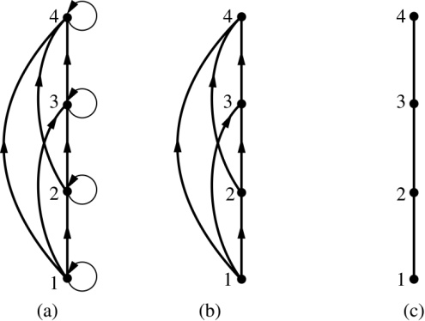
Hasse Diagrams
Definition: A Hasse diagram is a visual representation of a partial ordering that leaves out edges that must be present because of the reflexive and transitive properties.
A partial ordering is shown in (a) of the figure above. The loops due to the reflexive property are deleted in (b). The edges that must be present due to the transitive property are deleted in (c). The Hasse diagram for the partial ordering (a), is depicted in (c).

Slide 77
Procedure for Constructing a Hasse Diagram
To represent a finite poset (S,≼ ) using a Hasse diagram, start with the directed graph of the relation:
Remove the loops (a, a) present at every vertex due to the reflexive property.
Remove all edges (x, y) for which there is an element z ∈ S such that x ≺ z and z ≺ y. These are the edges that must be present due to the transitive property.
Arrange each edge so that its initial vertex is below the terminal vertex. Remove all the arrows, because all edges point upwards toward their terminal vertex.

